Slide 1
Occupational Specialism: Plumbing & Heating Engineering
K1.16 Scientific principles and concepts to plumbing engineering
Application and properties of liquids

Slide 2
Starter
Warm-up:
Name three types of liquids commonly used in building services and their purpose

Slide 3
Objectives
You should be able to:
Identify key applications of various liquids used in the industry.
Explain the physical and chemical properties of water.
Understand treatment and classification of water.
You might also be able to:
Assess the implications of using incorrect liquid types.
Evaluate the effect of liquid properties in plumbing and heating systems.

Slide 4
Applications of liquids – overview
Common liquids in the industry:
Water
Refrigerants
Anti-freeze/Glycol mixes
Fuel oils
Lubricants and greases.
These liquids serve different roles, from facilitating thermal transfer to providing lubrication or combustion energy.

Slide 5
Application – water
Water is the most commonly used liquid in plumbing systems. It is utilised for drinking supply, heating, cooling, and sanitary operations. It must meet strict quality standards to avoid health hazards and system damage.
Factors like pH, hardness, and microbial content are all controlled. The correct treatment of water ensures efficiency and longevity in plumbing systems. Regulations such as the Water Supply (Water Fittings) Regulations 1999 govern its use in building services.
Thames Water

Slide 6
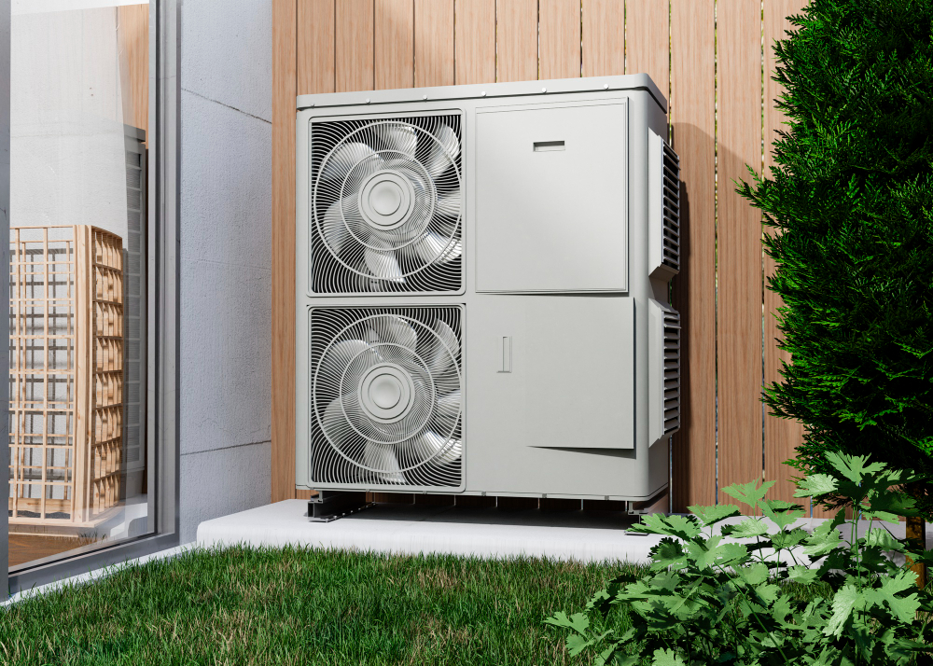
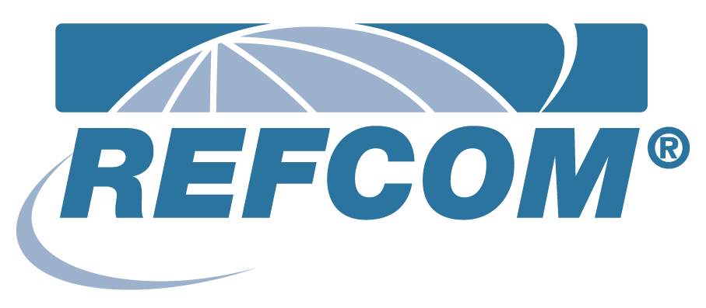
Application – refrigerants
Uses:
Heat pumps
Air conditioning systems
Examples:
R32, R410A
Note:
Must be handled in accordance with F-Gas regulations
Environmental regulations require low-GWP refrigerants

Slide 7
Application – anti-freeze/glycol mixes
Anti-freeze mixtures are critical in low-temperature systems like solar thermal and external pipework. Ethylene and propylene glycol are commonly used and mixed with water to lower the freezing point. These mixes also help reduce corrosion and biological growth.
However, concentration must be correct to avoid inefficiency. Periodic checks are essential to maintain effectiveness. Incorrect mixes can lead to freezing or overheating issues.
Question: What might happen to a heating system if the glycol mix is too diluted?

Slide 8
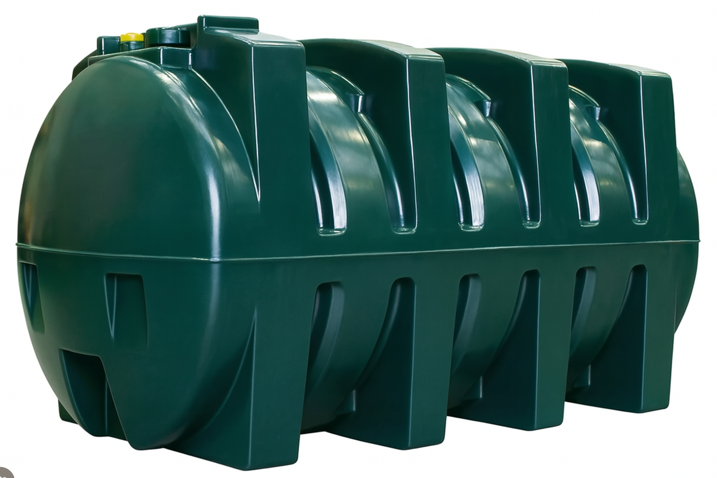
Application – fuel oils
Types:
Kerosene
Gas oil
Uses:
Fuel for boilers
Backup heating systems
Fuel oils are still widely used in rural and off-grid areas. They are stored in tanks and require good filtration and safety measures.

Slide 9
Application – lubricants and greases
Lubricants and greases prevent mechanical wear in pumps, valves, and moving joints. They extend equipment life and reduce energy consumption. Lithium and silicone-based greases are common in plumbing applications.
It is important to apply the correct type and amount of lubricant. Over-lubrication or using incompatible materials can lead to system failures. Always follow manufacturer recommendations.
Question: Why is it important to use the correct type of lubricant for soil stack assembly?

Slide 10
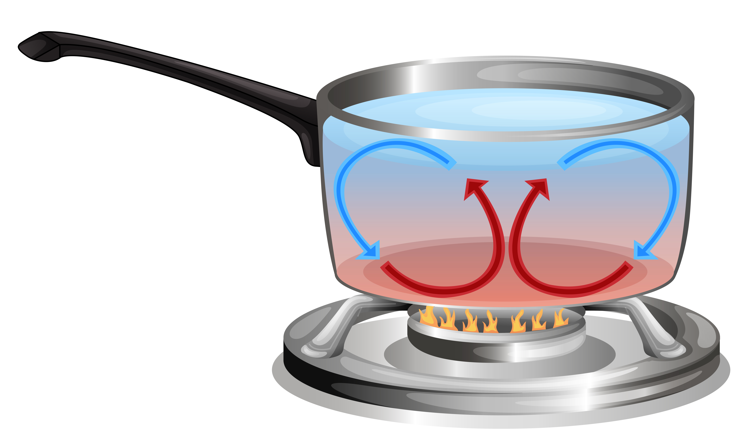
Boiling and freezing point
Water boils at 100°C and freezes at 0°C under standard conditions. These points can shift with pressure changes. For example, water boils at lower temperatures at high altitudes.
Impurities like salt or antifreeze agents also affect phase change temperatures. Understanding this helps when designing heating and hot water systems.

Slide 11
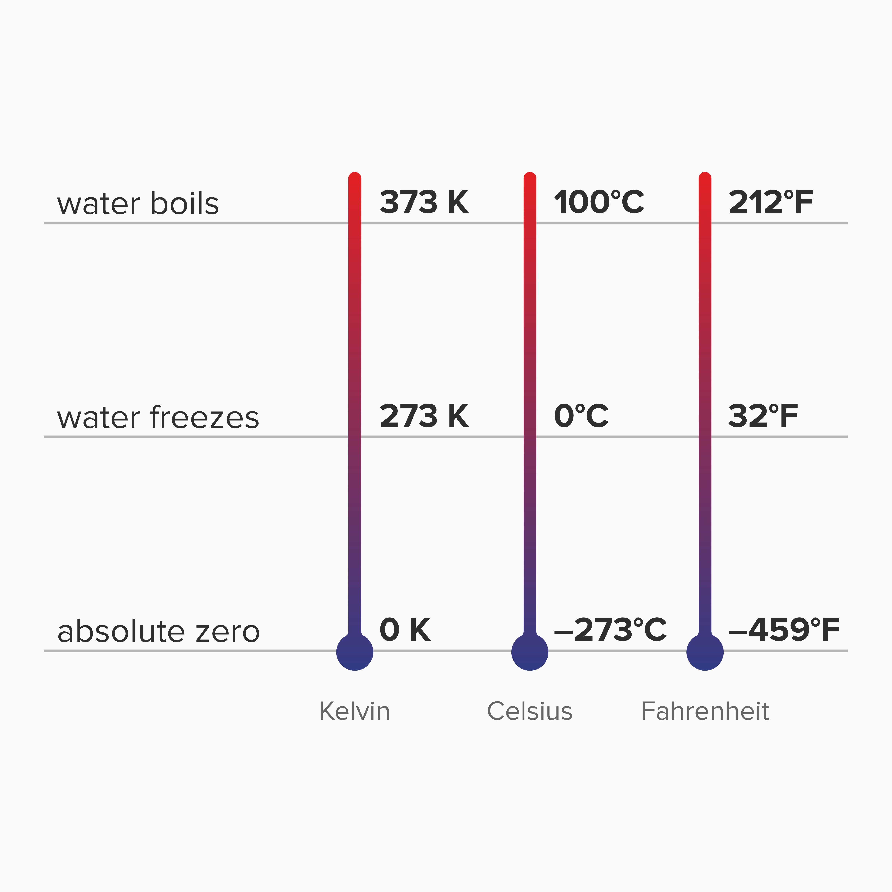
Celsius vs Kelvin
Celsius and Kelvin are temperature scales used in science and engineering. Celsius is based on water's freezing and boiling points. Kelvin starts at absolute zero (-273.15°C).
A change of 1°C equals a change of 1K, making conversion straightforward. Engineers often use Kelvin when dealing with thermodynamic calculations.
Question: What is the Kelvin equivalent of 25°C?

Slide 12
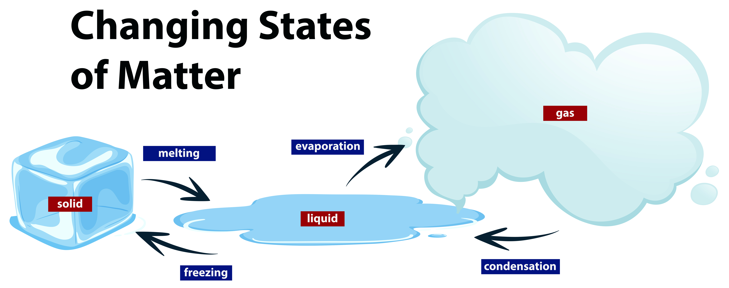
Change of state
Water changes between solid, liquid, and gas based on heat input. During boiling and melting, it absorbs or releases latent heat without changing temperature.
This energy transfer is key to understanding heat exchangers and radiators. Engineers must account for this when sizing systems to ensure performance and safety. Improper handling of phase changes can cause pipe bursts or steam burns.

Slide 13
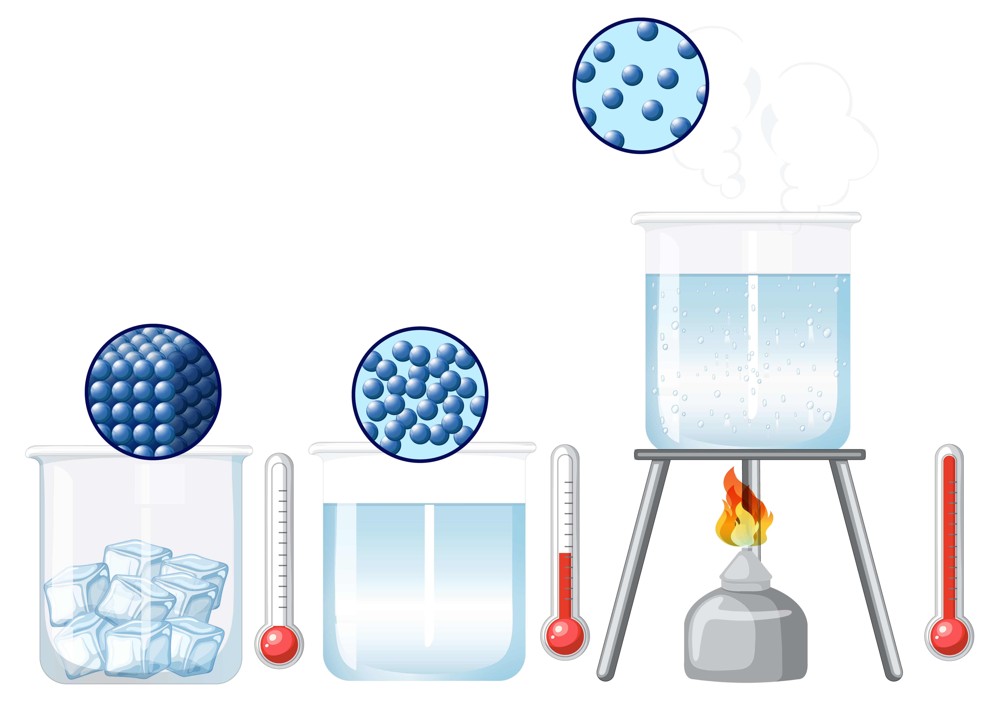
Molecular changes
Solid: tightly packed molecules
Liquid: freely moving
Gas: dispersed and energetic
These molecular changes affect fluid dynamics and thermal conductivity.

Slide 14
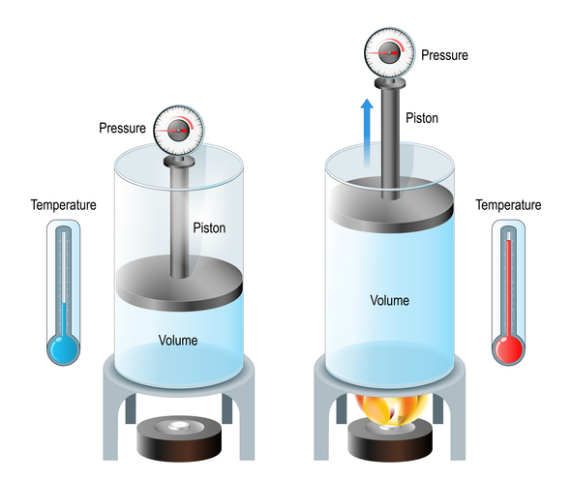
Volume and pressure relationship
As water heats up, its volume expands. In sealed systems, this causes pressure to rise. Expansion vessels are used to accommodate this change.
Without pressure relief, systems could burst.
This principle is governed by Charles’s Law and is critical in hot water system design.

Slide 15
Knowledge check 1
1. What is the boiling point of water at standard pressure?
2. Name two types of antifreeze used in plumbing.
3. What happens to water molecules when they change from liquid to gas?

Slide 16
Knowledge check 1 - answers
1. 100°C
2. Ethylene glycol, Propylene glycol
3. They gain energy and move farther apart.

Slide 17
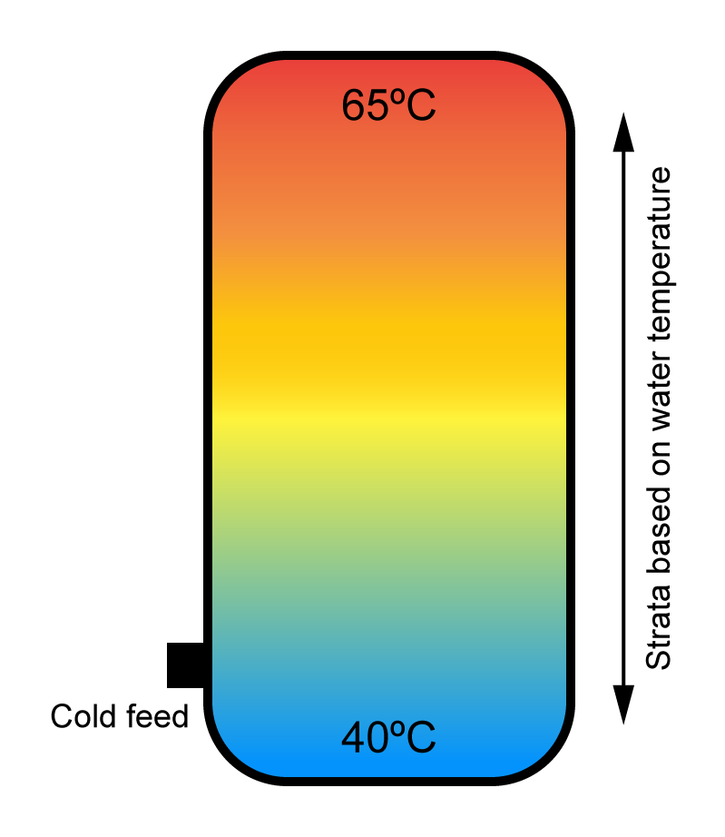
Density and temperature
Water has its maximum density at 4°C. Above and below this temperature, density decreases. This affects buoyancy and flow within heating systems.
Thermal layering or thermal stratification in cylinders occurs due to density differences.
Engineers must consider this when designing storage and distribution systems.

Slide 18
Steam and superheated steam
Steam is water vapour at 100°C, whereas superheated steam is further heated without condensation. It carries more energy and is used in high-efficiency heating systems.
However, it also poses a greater risk if not controlled properly. Steam systems require specific materials and safety valves. Improper management can lead to scalding or explosion hazards.
Question: Why is superheated steam more dangerous than regular steam?

Slide 19
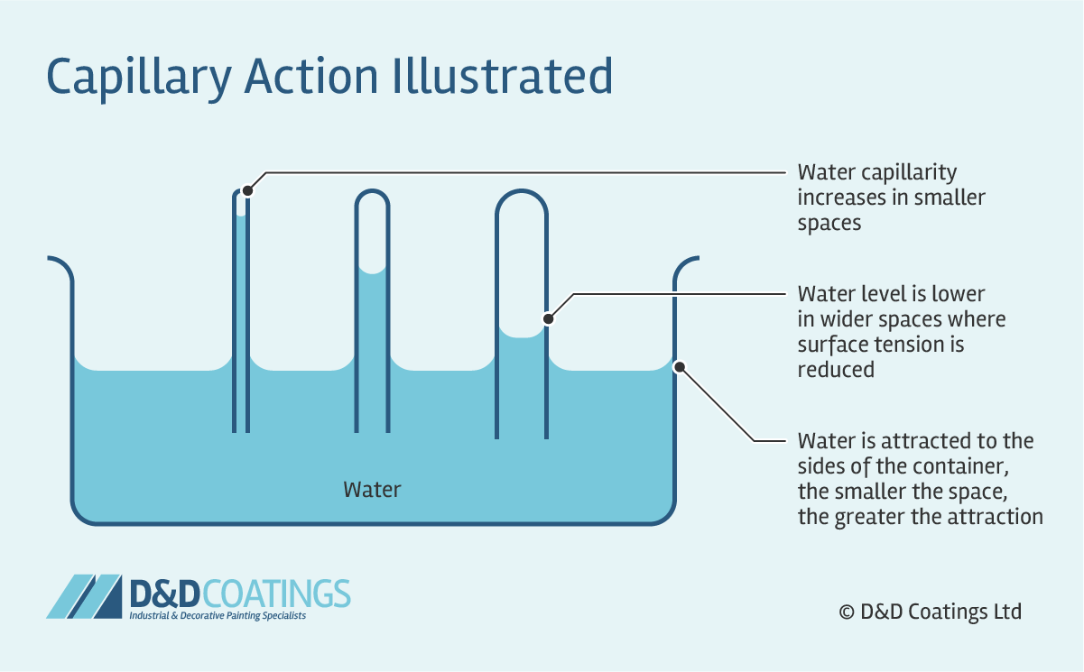
Capillarity
Capillarity allows water to travel through narrow spaces without gravity. It’s caused by surface tension (cohesion) and adhesion to surfaces. This is an essential for effective soldered joints.
Plumbers and design engineers utilise this property in small-pipe or low-flow devices too.
However, capillary action can also allow water to penetrate into a property (incorrectly fitted lead flashings) and can lead to trap seal loss (s-traps especially).

Slide 20
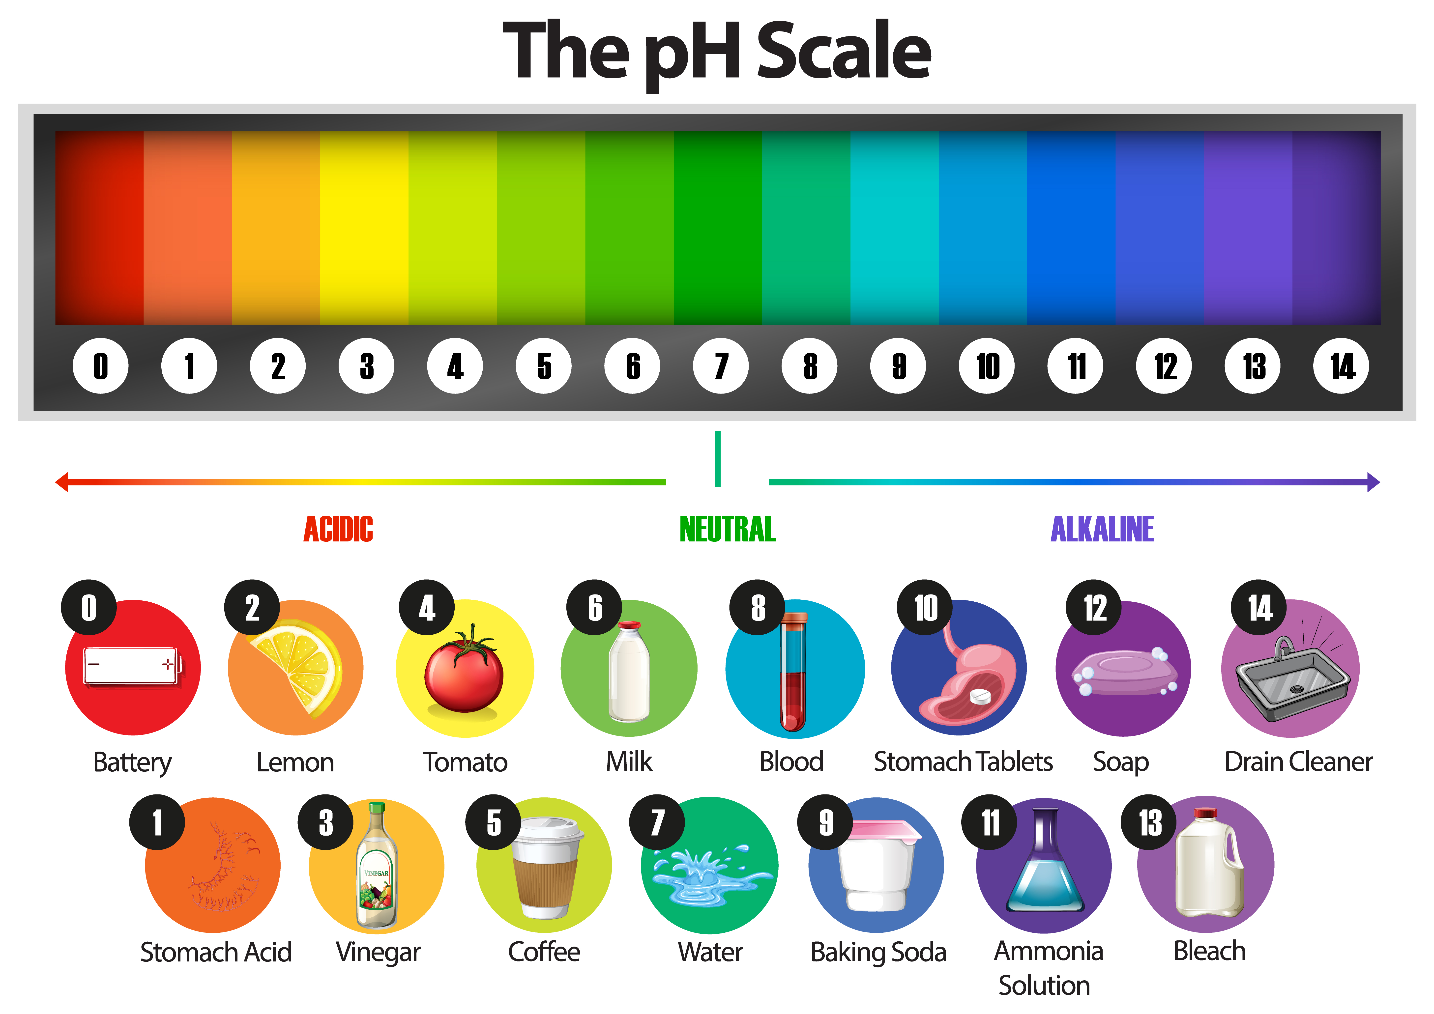
Acidity and alkalinity (pH)
The pH scale ranges from 0 (acidic) to 14 (alkaline). A neutral pH is 7.
System water should stay close to neutral to avoid corrosion. Acidic water eats away metal, while alkaline water can lead to scaling. Inhibitors can balance pH levels.
Question: Is hard water acidic or alkaline? What type of water do you have in your area?

Slide 21
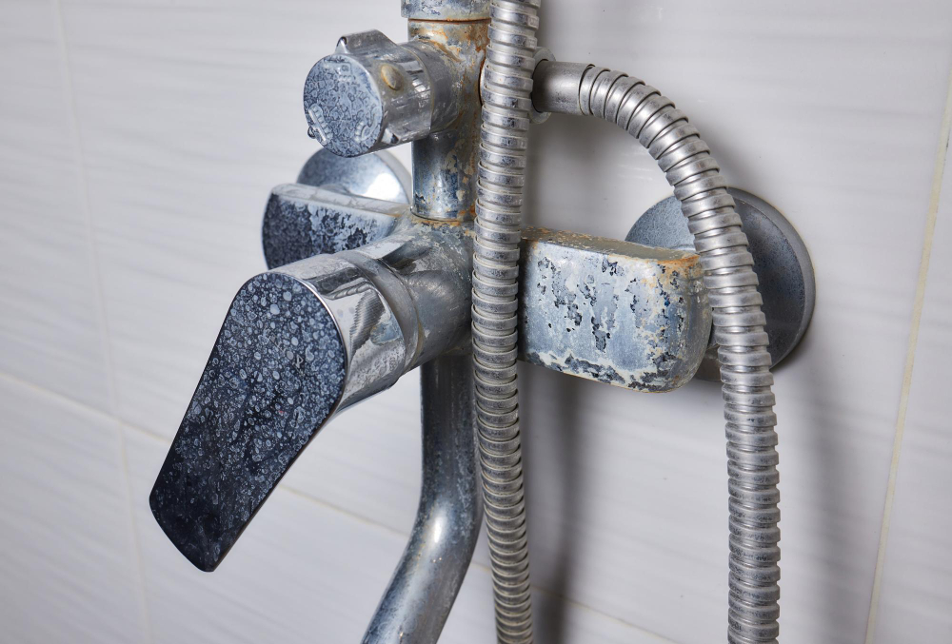
Hardness of water
Hard water contains calcium and magnesium. It causes limescale buildup in pipework and appliances.
Scale reduces efficiency and can lead to breakdowns.
Water softeners remove these minerals. Regions with hard water require additional treatment steps.
Notes:
For tutors: Link to water hardness map - https://www.bristan.com/hard-water-map

Slide 22
Types of water hardness
Soft water: Low mineral content
Temporary hard: Minerals removed by boiling
Permanent hard: Requires chemical treatment
Understanding these distinctions helps in choosing treatment methods. Hardness levels vary by region and have an impact on plumbing design and system performance.

Slide 23
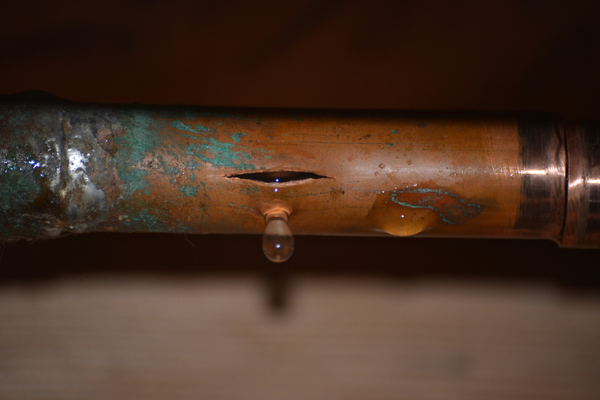
Chemical states of water
Water naturally cycles between solid, liquid, and gas. In heating systems, these states are deliberately manipulated. Design must accommodate expansion, contraction, and condensation.
Failure to do so can lead to ruptures or inefficiencies. Materials used must tolerate these changes.

Slide 24
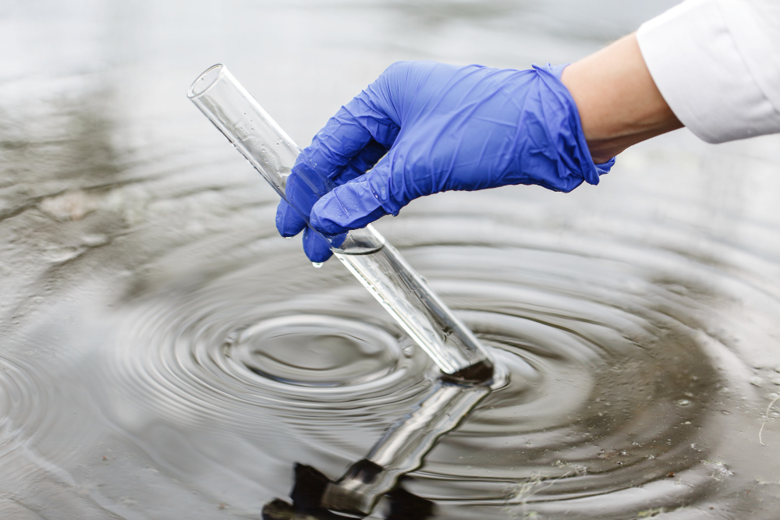
Water quality
Water quality influences performance and safety. Factors include pH, hardness, microbes, and particulates.
Untreated water causes corrosion, blockages, and health hazards. Systems should be designed with quality in mind.
Regular testing and treatment prevents expensive damage.

Slide 25
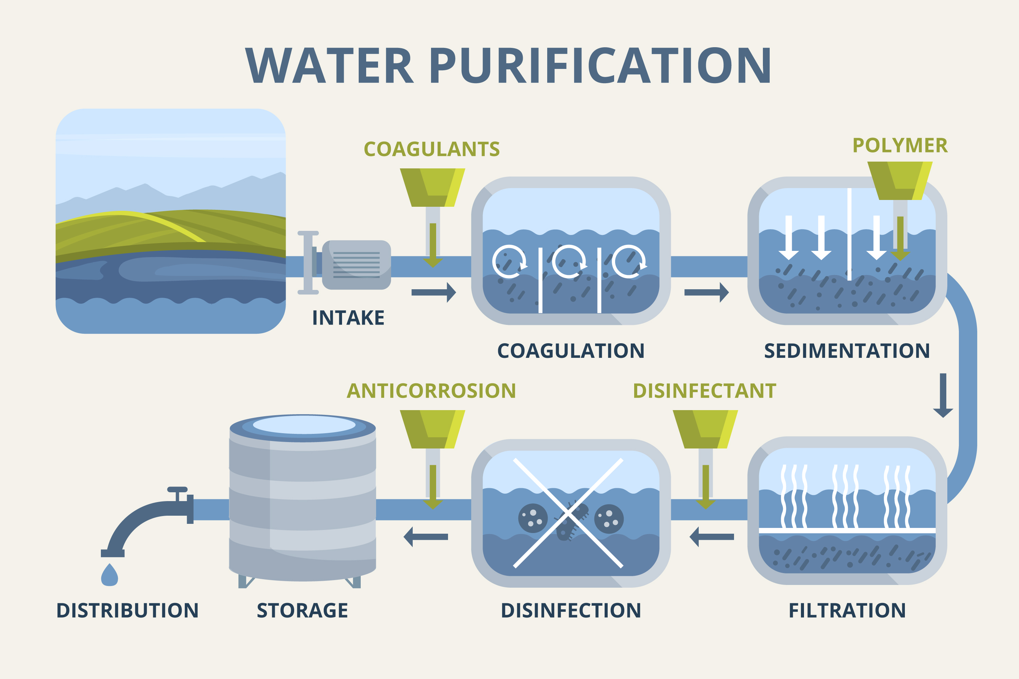
Water quality
Sediments
Microbial growth
Dissolved gases
Heavy metals.
Contaminants must be filtered or neutralised to meet legal and functional standards.
Question: Who is your local water undertaker?

Slide 26
Knowledge check 2
What is the ideal pH range for system water?
Name two types of water hardness.
What does capillary action rely on?

Slide 27
Knowledge check 2 - answers
7 to 8
Temporary, Permanent
Surface tension (cohesion) and adhesion

Slide 28
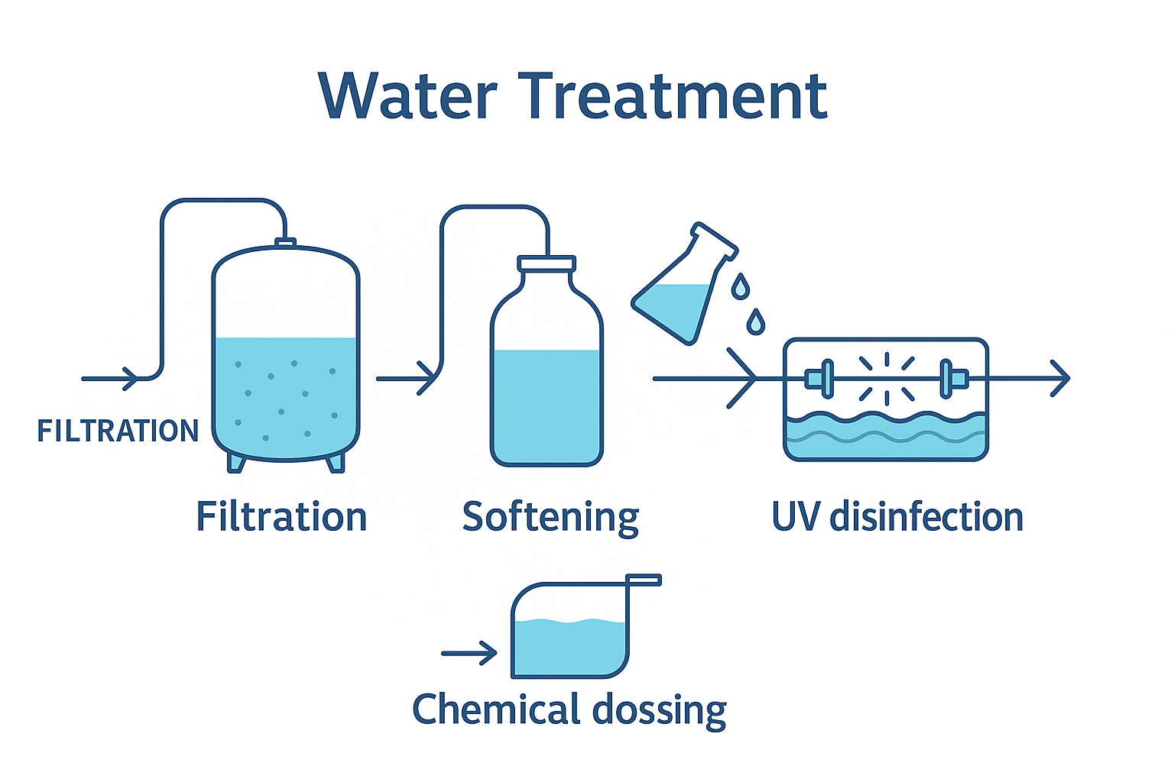
Water treatment – overview
Treatment methods:
Filtration
Softening
Chemical dosing
UV disinfection
Different systems require different treatments depending on use and source.

Slide 29
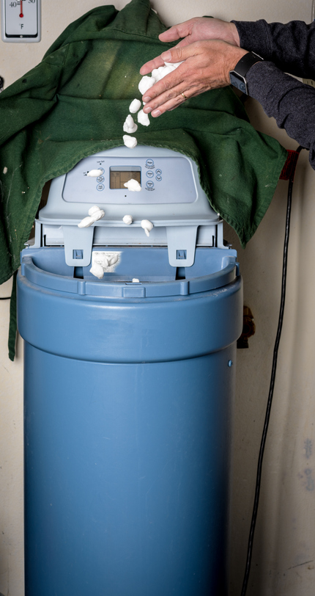
Water softening
Softening uses ion-exchange to replace calcium/magnesium with sodium. It prevents scale and improves appliance longevity. Devices must be maintained regularly.
Over-softening may introduce other issues like corrosion. Testing post-treatment is necessary.

Slide 30
Magnetic and electrolytic treatment
These systems prevent scale by altering mineral structure. They are easy to install and require little maintenance.
They are not always effective for high-hardness areas, and are often used alongside softeners.
Environmentally friendly solution.
Notes:
For tutors: Link to magnetic scale inhibitor at RS Components - https://uk.rs-online.com/web/p/scale-inhibitors/7382719

Slide 31
Corrosion inhibitors
Corrosion inhibitors form a protective film on metal surfaces. They reduce oxidation and scale within heating systems and extend the life of the vulnerable components.
The dose and water quality should be checked annually as part of a system service.
Most inhibitor bottles come with a label to inform the customer when the system needs to be checked. You should apply the label to the boiler case or filter.
Notes:
For tutors: Link to Corrosion Inhibitor on RS Components - https://uk.rs-online.com/web/p/rust-treatments/7805265?msockid=0c3d5a44387e6119166e4f373959602c

Slide 32
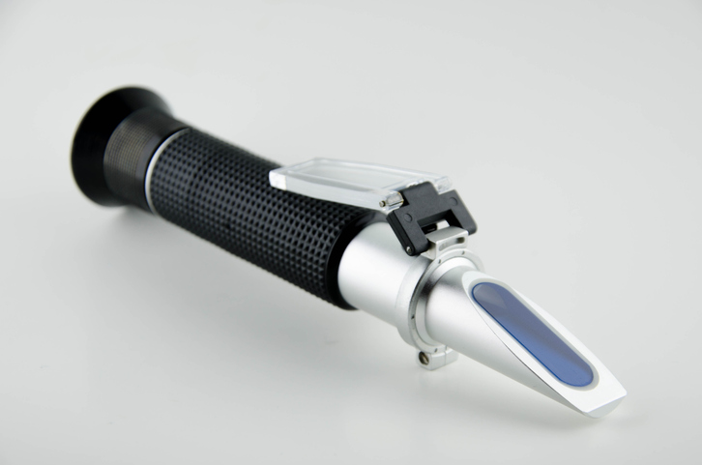
Biocides and anti-freeze
Biocides control bacterial growth like Legionella, while Anti-freeze (such as Glycol) prevents freezing in exposed systems.
Biocides are commonly required for underfloor heating circuits.
Both are critical for safe, reliable operation. Concentrations must be monitored, and dosing systems ensure correct amounts.

Slide 33
Monitoring and testing
Routine testing includes:
pH
Hardness
Conductivity
Bacteria count.
Testing schedules vary by system type. Results guide treatment adjustments.

Slide 34
Summary of applications
Water: universal use
Refrigerants: heat transfer
Glycol: freeze protection
Fuel oils: energy supply
Lubricants: mechanical care
Each has a unique role, requiring proper handling and maintenance.

Slide 35
Summary – water quality and treatment
Quality affects:
System lifespan
Health and safety
Operating costs.
Proper treatment ensures efficiency and compliance.
Question: Have you ever been notified of contamination to your water supply?

Slide 36
Scenarios
Question: What water and additives would you expect to find in;
Sealed central heating system (double convectors running at 65°C).
Underfloor heating system (operating at 25°C to 28°C).
Solar thermal system.
Question: What would the outcome be for each system if the fluid type or ratio was unsuitable?

Slide 37
Discussion task
Question: How would poor liquid selection and maintenance impact a commercial heating system?
Small groups to discuss and feed back with examples.

Slide 38
Optional activity – pH test
Hands-on with pH strips:
Tap water
Softened water
Primary water
Compare values and discuss results.

Slide 39
Knowledge check 3
Name one use of refrigerants in building services.
What does a corrosion inhibitor do?
What common plumbing process utilises capillary action?

Slide 40
Knowledge check 3 - answers
Heat pump / air conditioning
Protects metal surfaces inside systems
End feed soldering or brazing

Slide 41
Extension question
Question: Explain how changes to water density influenced the design and installation method of hot water cylinders.

Slide 42
Summary
You should now be able to:
Identify different types of liquids used in plumbing and heating systems.
Explain key physical and chemical properties of water.
Understand water treatment methods and classifications.
You might also be able to:
Assess how incorrect liquid selection affects system performance.
Evaluate the impact of liquid properties on the efficiency and safety of plumbing and heating designs.

Slide 43
Any questions?
Copyright in this document belongs to and is used under licence from the Department for Education, © 2025.
‘T-LEVELS’ and ‘T Level’ are registered trademarks of the Department for Education.
WJEC is authorised by the Department for Education to develop and deliver this T Level Technical Qualification.
WJEC operates in England under the name Eduqas which is a registered trademark of WJEC.

